Slide 1
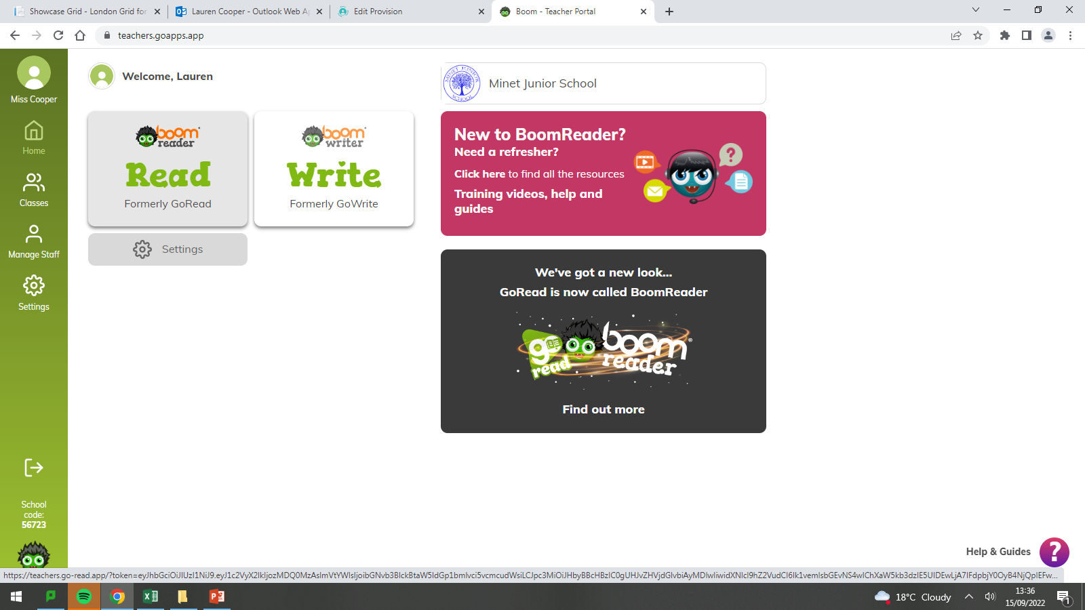

Slide 2
Reading
This scheme is in place of the reading records that were sent home
Your child will still receive a physical book from the school, but instead of writing in the reading record, the reading will need to go on Go-app
When reading, the child should write a comment or summary in the box about what they have read.

Slide 3
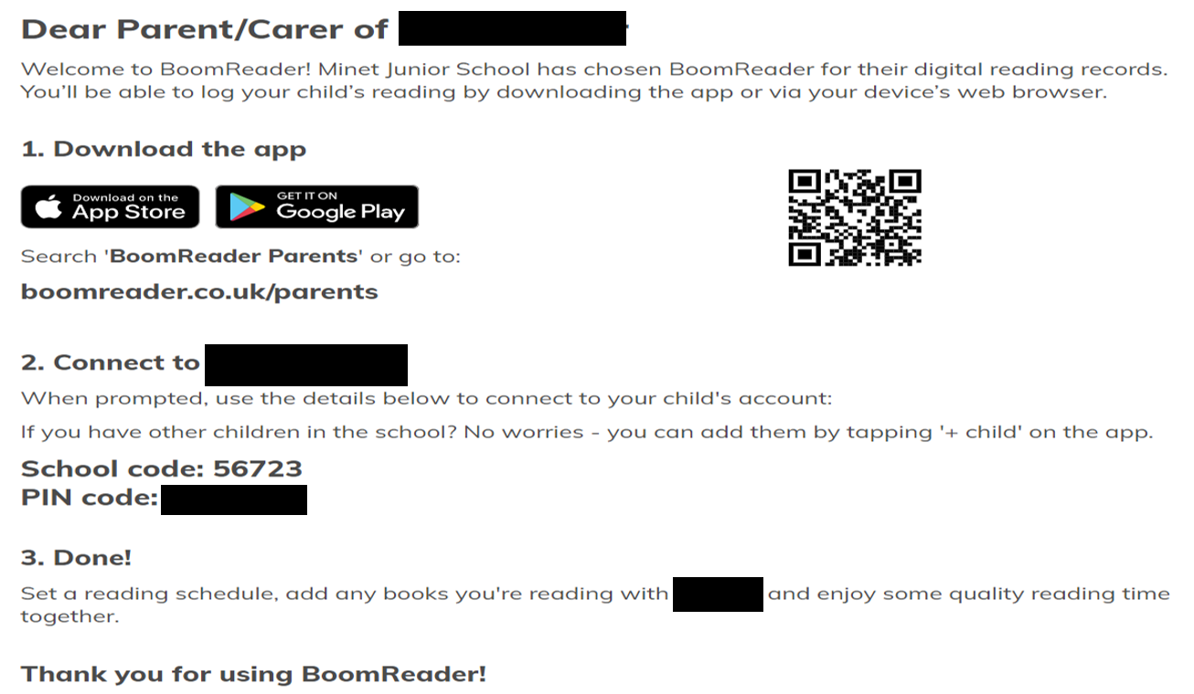
Each of you will have received a registration letter with your child

Slide 4
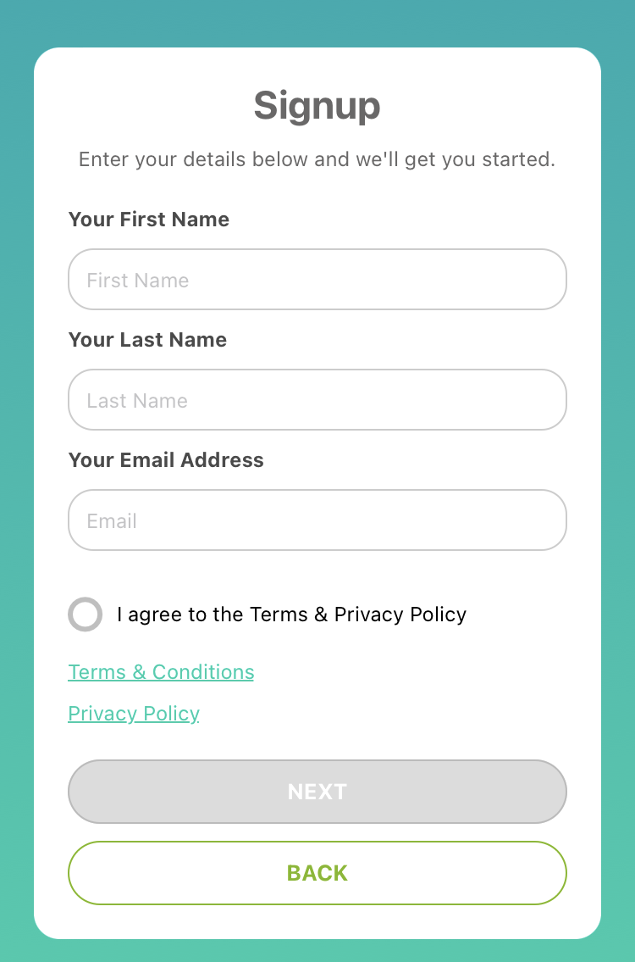
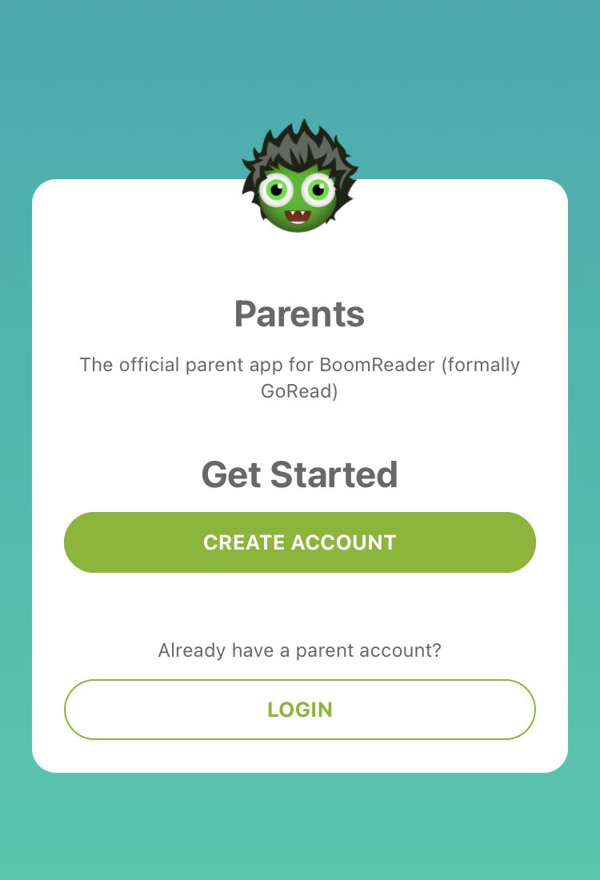
PARENT LOGGING
When you scan the QR code, you will be prompted to download the app and then this will come up.
You will need to create an account with an accessible email address

Slide 5
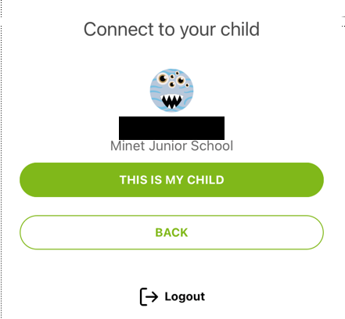
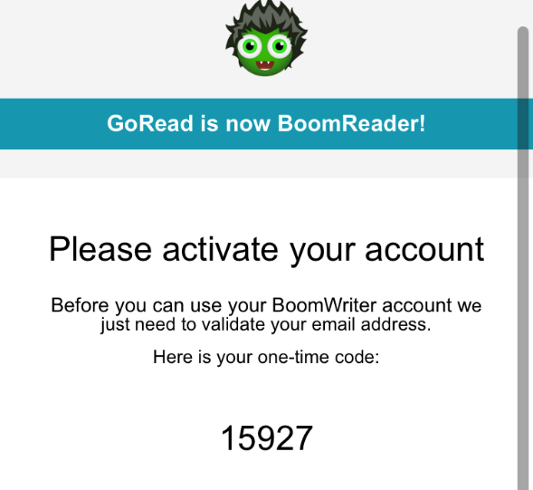
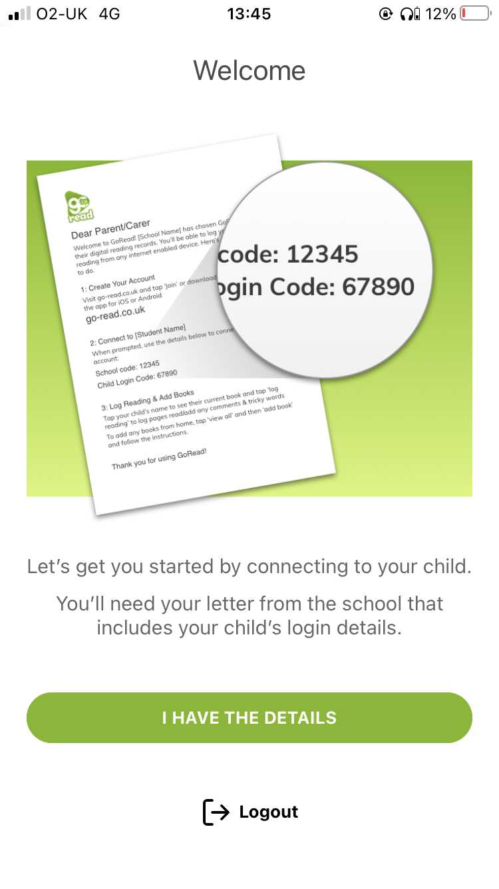
The app will then prompt you to type in you’re the school code: 56723
And then their individual code
You will then receive an activation code
You will then be prompted to connect to your child. Make sure you have typed the number in correctly.

Slide 6
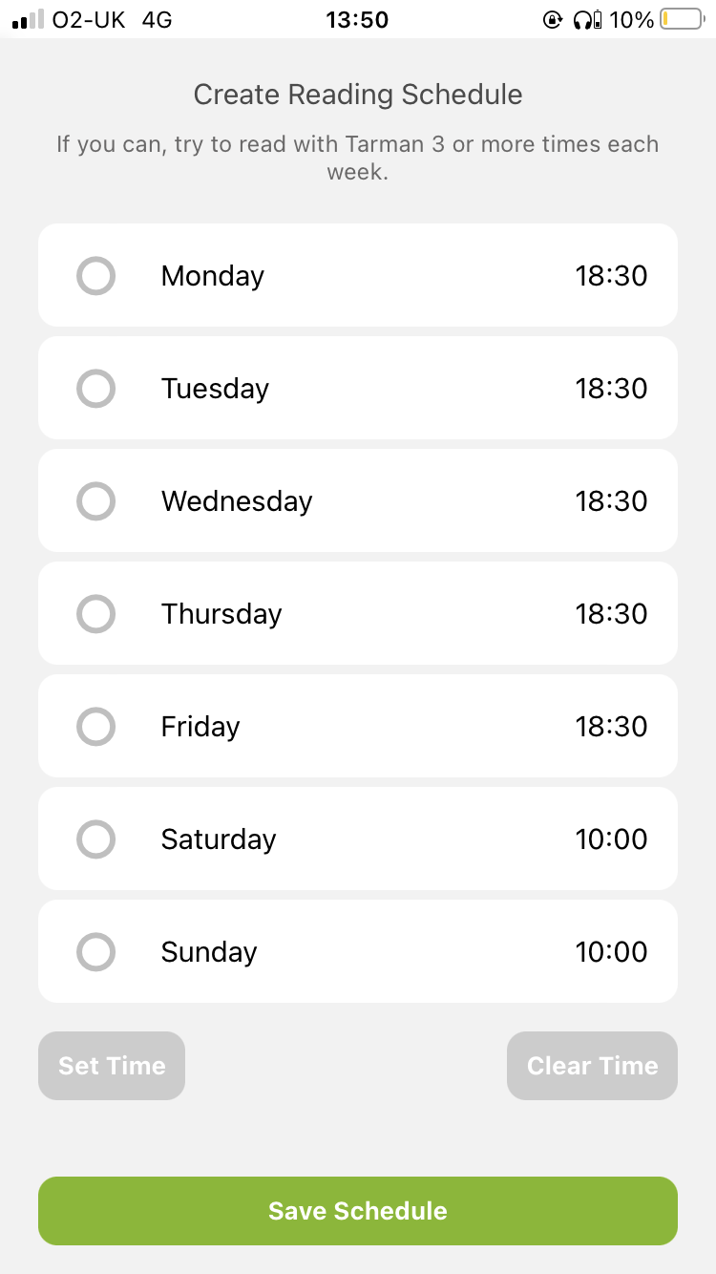
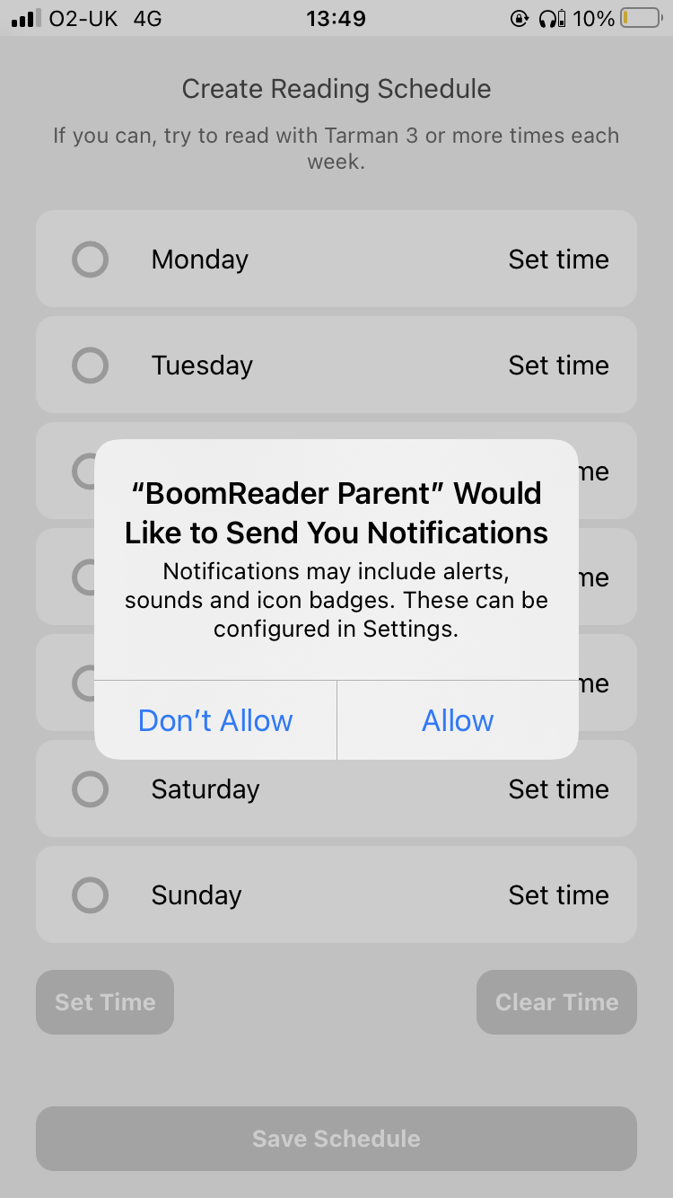
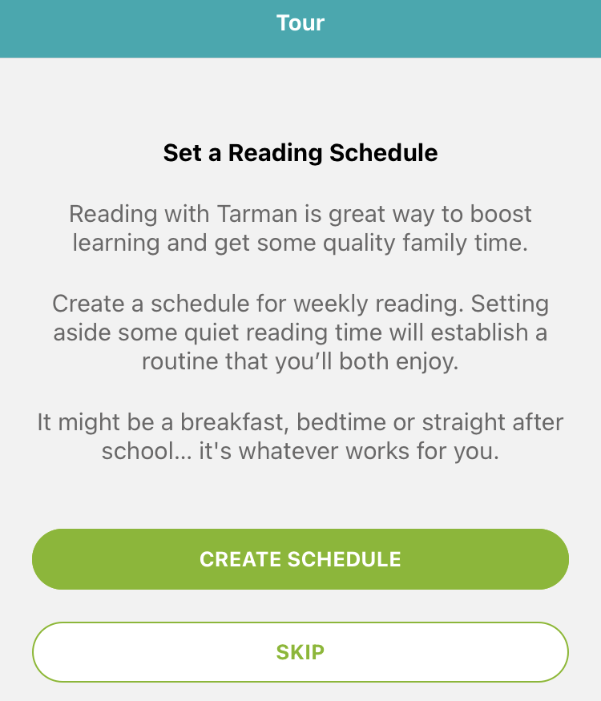
You can create a reading schedule which is basically a reminder to read on your phone

Slide 7
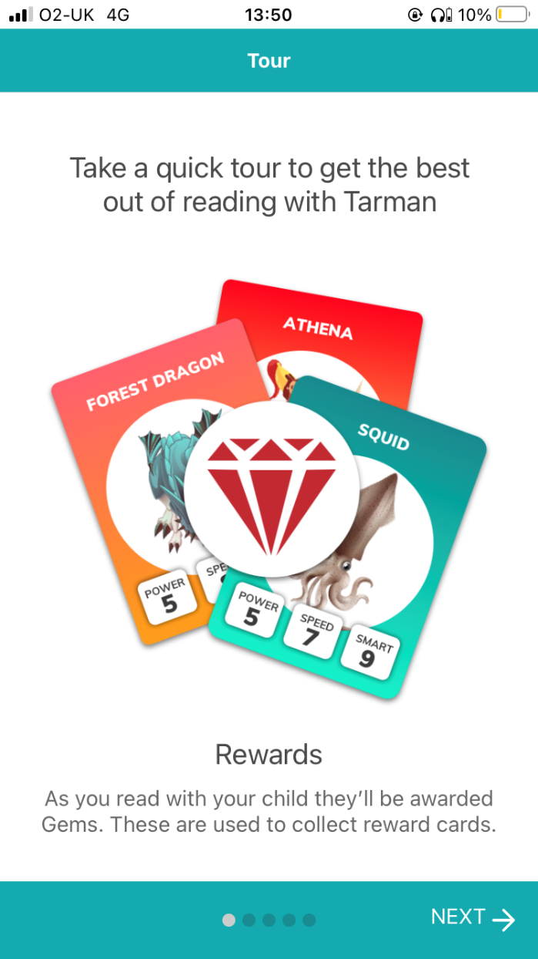
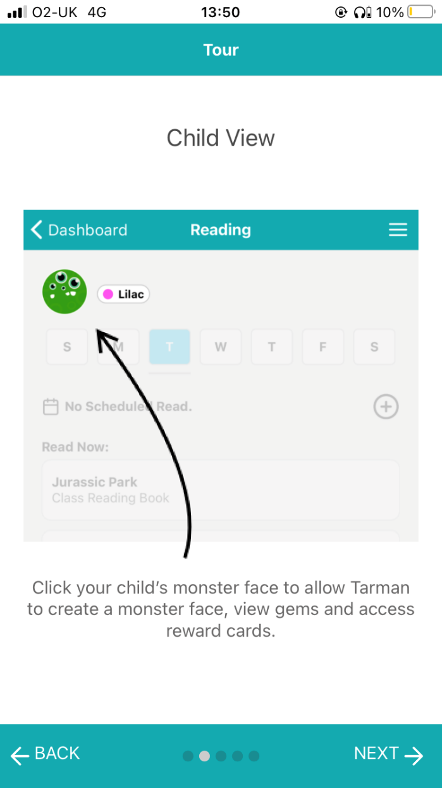
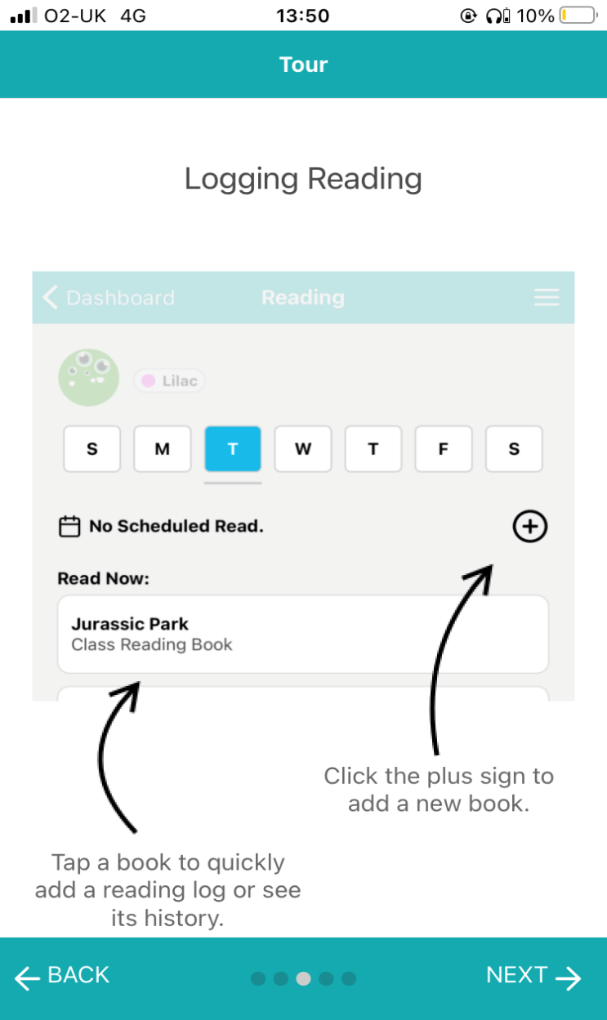
You will then be taken on a tour of the app

Slide 8
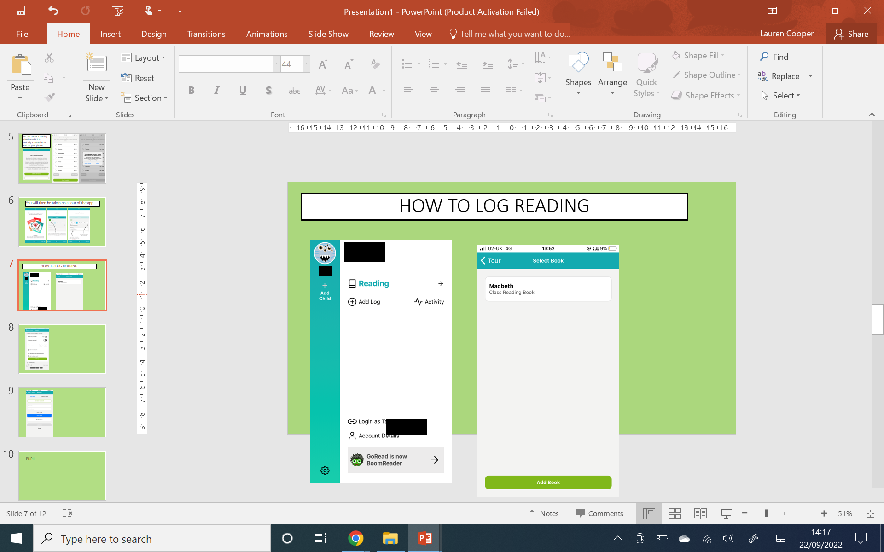
HOW TO LOG READING
Here you will see your child’s home page and their activity
Click add log
If you have more than one child, you can add them here using their code

Slide 9
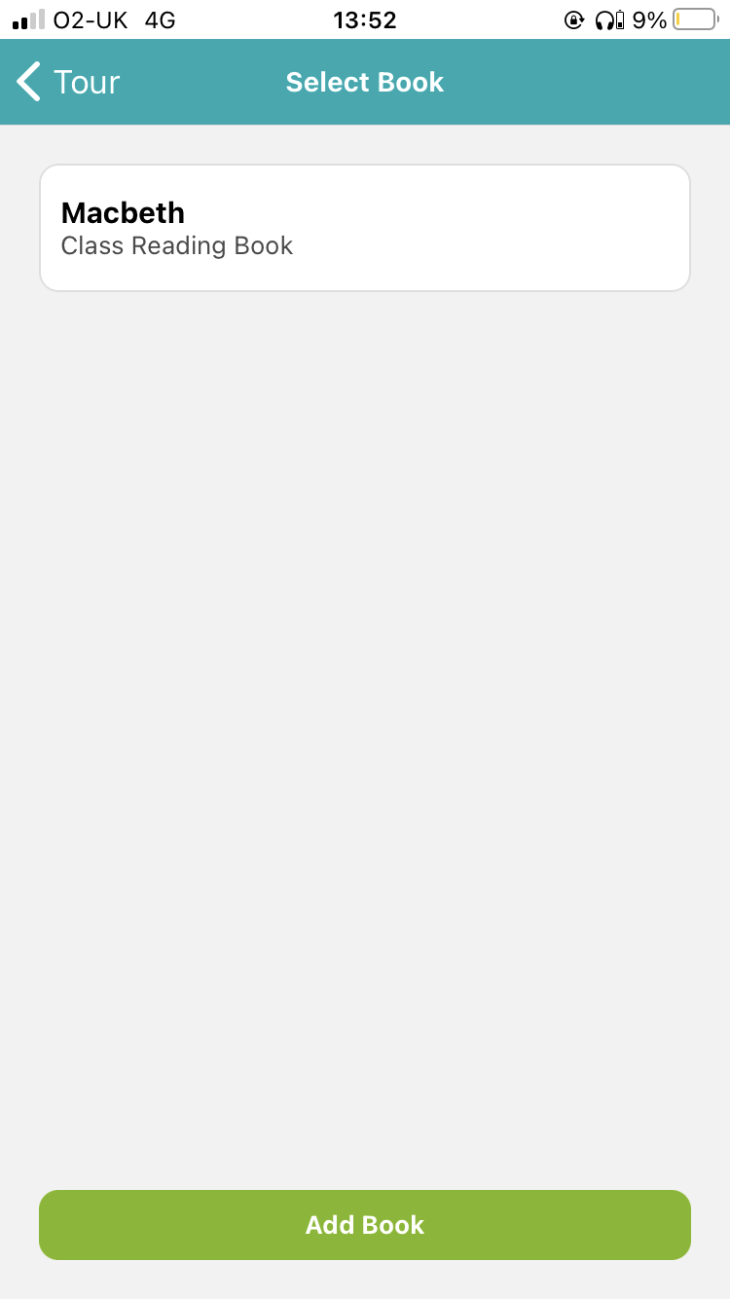
Select whichever book you have read with them
Your child may have a library book also, or any additional books they are reading at home

Slide 10
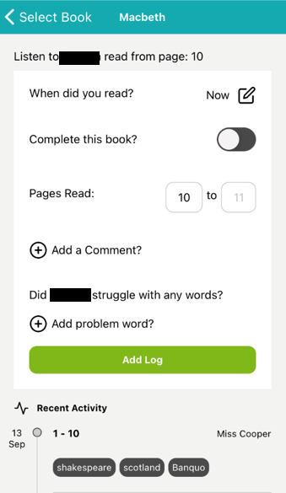
When you read with your child
Your child must write a summary of what they’ve read each time
Select if the book is finished
Pages read
If your child struggled with any word, add it here
Add log to complete

Slide 11
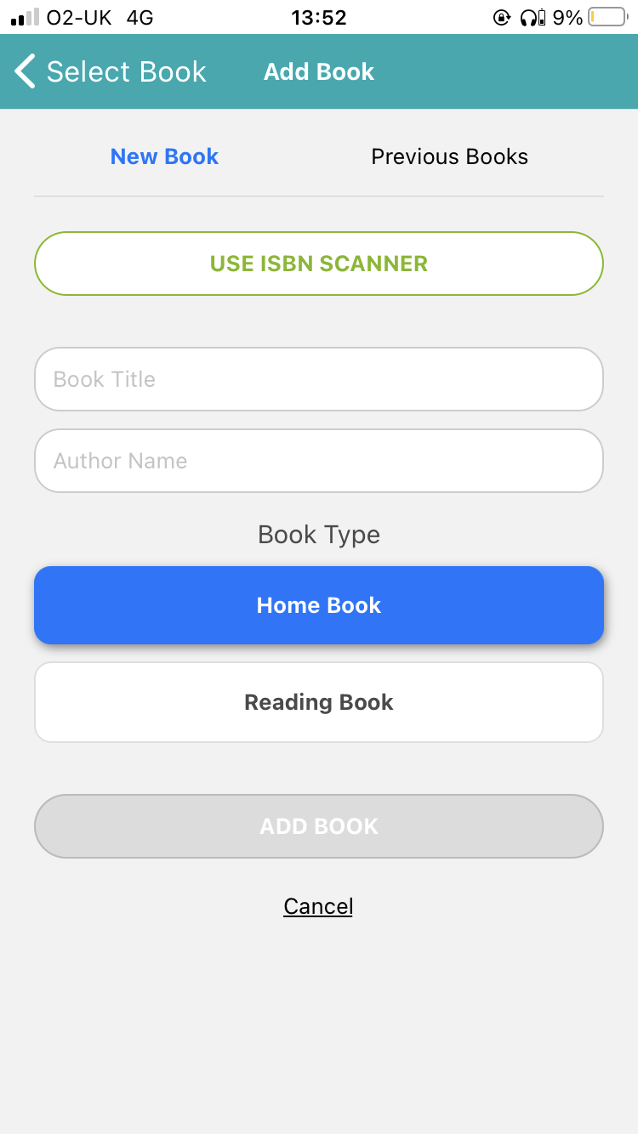
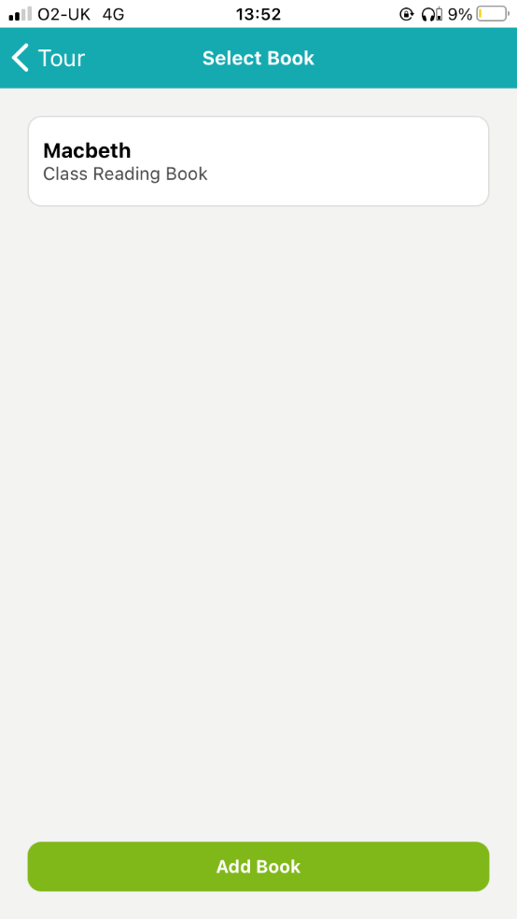

Slide 12
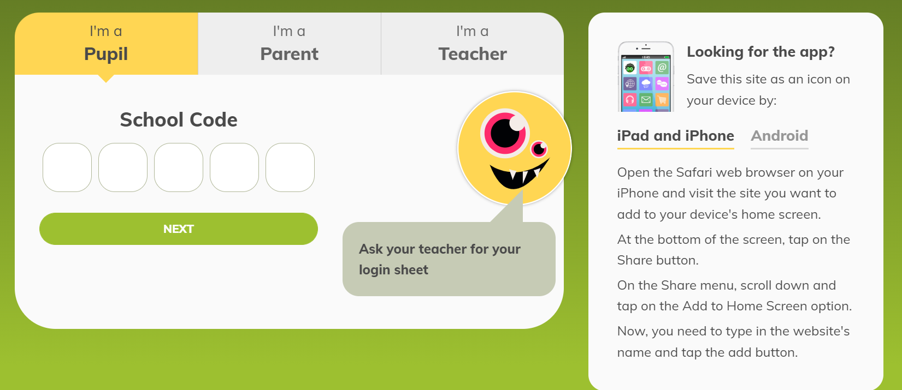
PUPIL LOGGING

Slide 13
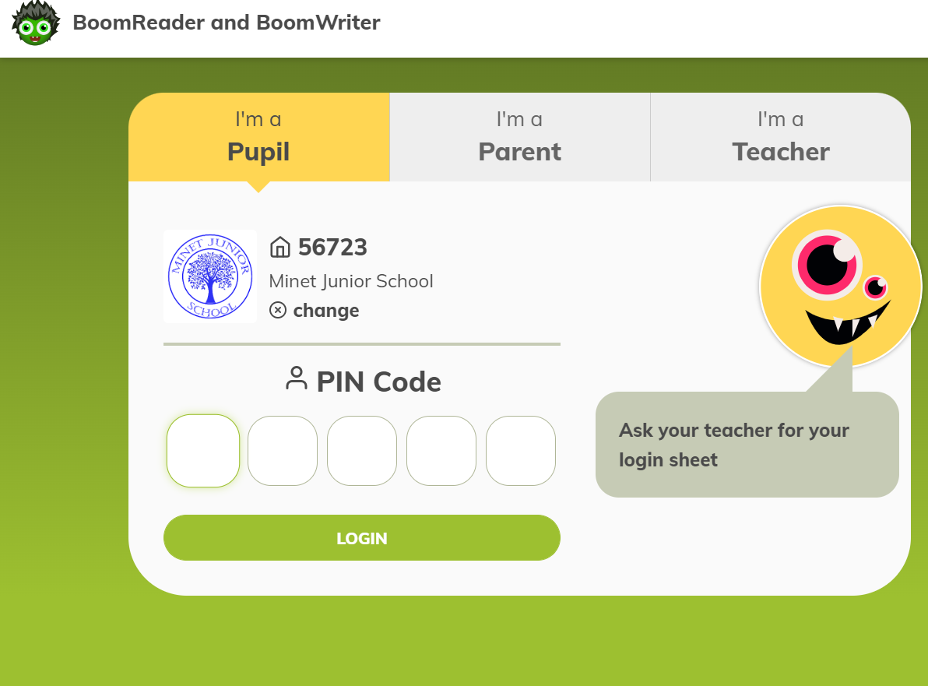

Slide 14
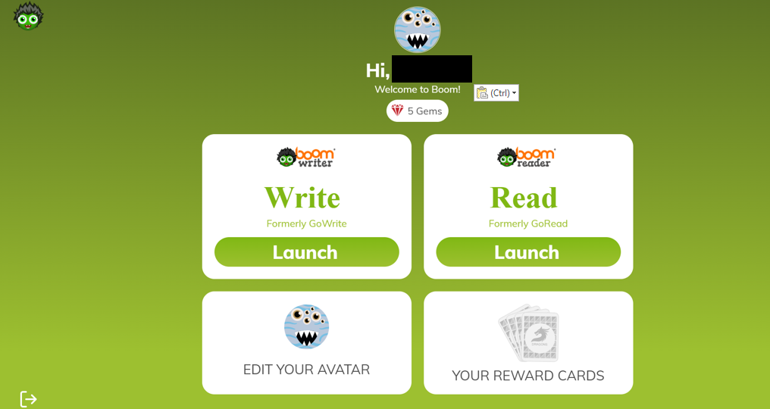
Log your reading
Edit your monster
Your reward cards

Slide 15
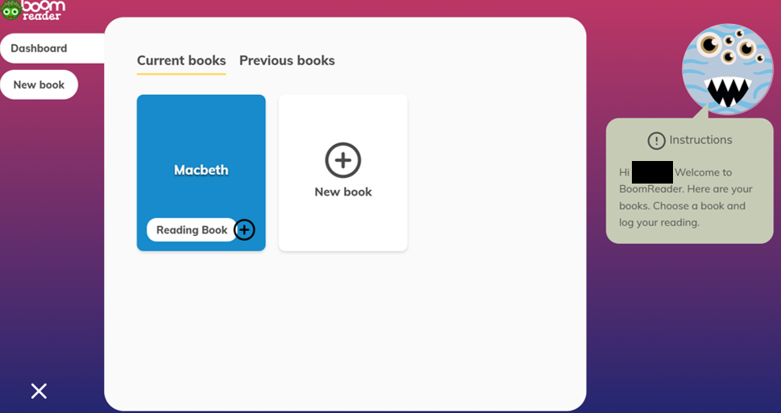
Click the plus on the book you’re reading

Slide 16
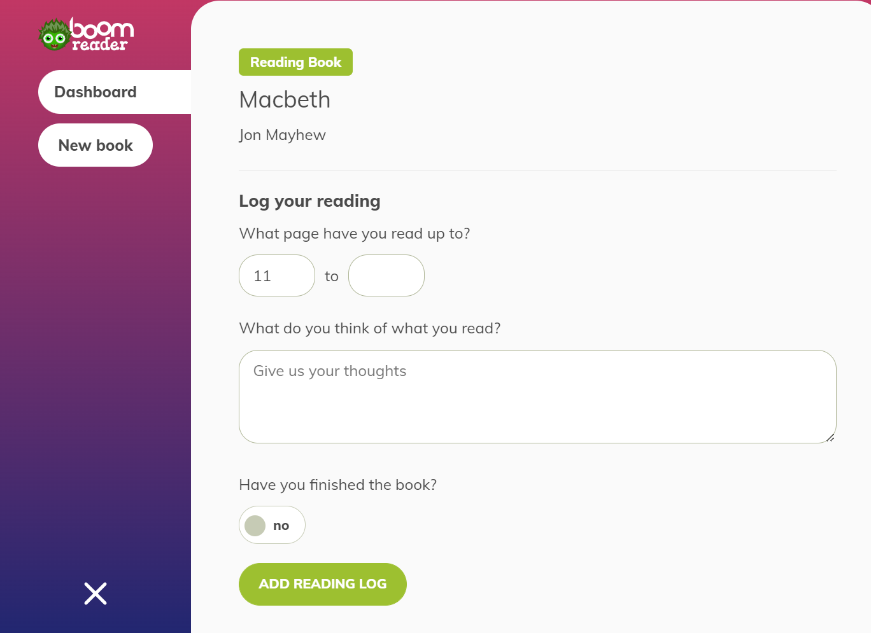
Fill in the pages you’ve read
Write a comment about what you’ve read
Add our log

Slide 17
What to log as what ?
Parent logging – Reading with your child
Reading the books that we send
home from school
Pupil logging – Individual reading

Slide 18
When a book is finished
Children to bring their book back to school and find their bookmark with their name on.
Put the bookmark inside the book
The book will then be changed for them and logged with a new book

